Slide 1












Developing Custom Health Dashboards (with Dynamo and Power BI)
DBWA2023, Session 212
PRESENTATION
Presenters:
Sean McDonald
Corporate BIM Manager
Tieyi Yu
Digital Design Technologist
DIGITAL BUILT WEEK AMERICAS
JUNE 15-17, 2023 | DALLAS, TEXAS

Slide 2
Session Description
'Model health' is a BIM buzzword that frequently lacks specific meaning or universal understanding – by nature, the concept is specific to an organization, project, or even role. Consequently, BIM data must be ‘flexible’ as different project roles require different levels of data detail (or collection rates) to support decisions or be actionable. Dynamo and Power BI are one combination of tools that empowers users to develop DIY model health dashboards. In this lab session, we will walk you through the process of creating those dashboards and underlying data models using Dynamo and Power BI. We will also discuss key considerations for scaling such workflows beyond individual models.
Learning Objectives
At the end of this session, participants will be able to:
Identify sources of model data and run Dynamo scripts to programmatically extract this data to JSON files
Load data into a PowerBI template and automate data extraction, transform, and loading (ETL) tasks
Develop interactive, visually compelling reports and templates to automate your workflow as much as possible.
Note: While you can develop your own health metrics, we provide one for the session.
___________________________________________
Questions related to specific materials, methods, and services will be addressed at the conclusion of this presentation.
DIGITAL BUILT WEEK AMERICAS
Session 212
JUNE 15-17, 2023 | DALLAS, TEXAS
Notes:
Mandatory slide - no need to cover in depth as attendees should know prior to attending but included as a refresher

Slide 3
Motivation / ‘The Problem’
Model Review is Challenging:
Checking Revit models is resource intensive!
Time-consuming, tedious, and inconsistent when performed manually
Not easy to query / search elements in model using Revit UI
Indicators inform adherence to company standards or QA/QC requirements, but importance is specific to company
Need ability to diagnose model health quickly, consistently, on demand
Checks yield info regarding potential model health or performance issues
Better data allows modelers to ask better questions
Some typical questions for models…
How many views are on sheets (or not?)
Is my project using the correct templates or standards?
How many model elements are impacted by warnings?
Is there an unexpected number of object or line styles in the model?
Can I dump model data to Excel for further analysis?
What files are attached to my model?
DIGITAL BUILT WEEK AMERICAS
Session 212
JUNE 15-17, 2023 | DALLAS, TEXAS
Notes:
Since dynamo script and Power BI template already built, typical Revit user should be able to play scripts and generate report on their own
Empowers staff to diagnose issues their own models with a consistent output

Slide 4





One Potential Solution:
Step 0: Initial Setup / File Deployment
Step 1: Update Dynamo scripts to specify output details
Step 2: Run Dynamo scripts on a sample Revit model (produce data outputs as JSON files)
Step 3: Configure Power BI template to read JSON data
Step 4: Refresh and customize Power BI Report
Step 5*: Publish Power BI Report to a workspace (*OPTIONAL: Power BI Pro users only)
STEP 0
STEP 1
STEP 2
STEPS 3-4
STEP 5
DIGITAL BUILT WEEK AMERICAS
Session 212
JUNE 15-17, 2023 | DALLAS, TEXAS

Slide 5

0
1
2
Shortcuts to specific steps in demo
3
LAB INSTRUCTIONS + DEMONSTRATION
4
5
Slides in the next sections are intended to help users recall steps outside of presentation/lab session
We will go over content directly in Dynamo and Power BI rather than talking over slides
Slides with this icon on the top-right corner are discussed in Dynamo / Power BI for the live presentation
DIGITAL BUILT WEEK AMERICAS
Session 212
JUNE 15-17, 2023 | DALLAS, TEXAS
Notes:
This slide deck serves two purposes:
Use in live session presentation, but will skip over certain slides demonstrated live
For self-paced instructions if followed outside of live demo
Thus, the actual presentation is shorter for the live demo, but longer in case users want the main details presented live.

Slide 6
Lab Requirements and Initial Setup
Software Requirements
Revit 2021 (or later)
Dynamo (+3 packages)*:
archi-lab.net (2023.213.1722)
Spring Nodes (210.1.1)
JsonData (2.02)
*NOTE: We have reduced the number of required packages from the original proposal to reduce chances of conflicts or errors
Power BI
Use Desktop (free) to edit and customize template
Have April 2023 update (or later) installed
If you have Pro (paid), you may also publish reports
Helpful to already have a workspace you can publish to
DIGITAL BUILT WEEK AMERICAS
Session 212
JUNE 15-17, 2023 | DALLAS, TEXAS
Notes:
No need to cover in depth since info was in the lab description so
Just remind about requirements
lab is intended for Revit 2021
Dynamo packages
Power BI requirements (April 2023 or later)

Slide 7
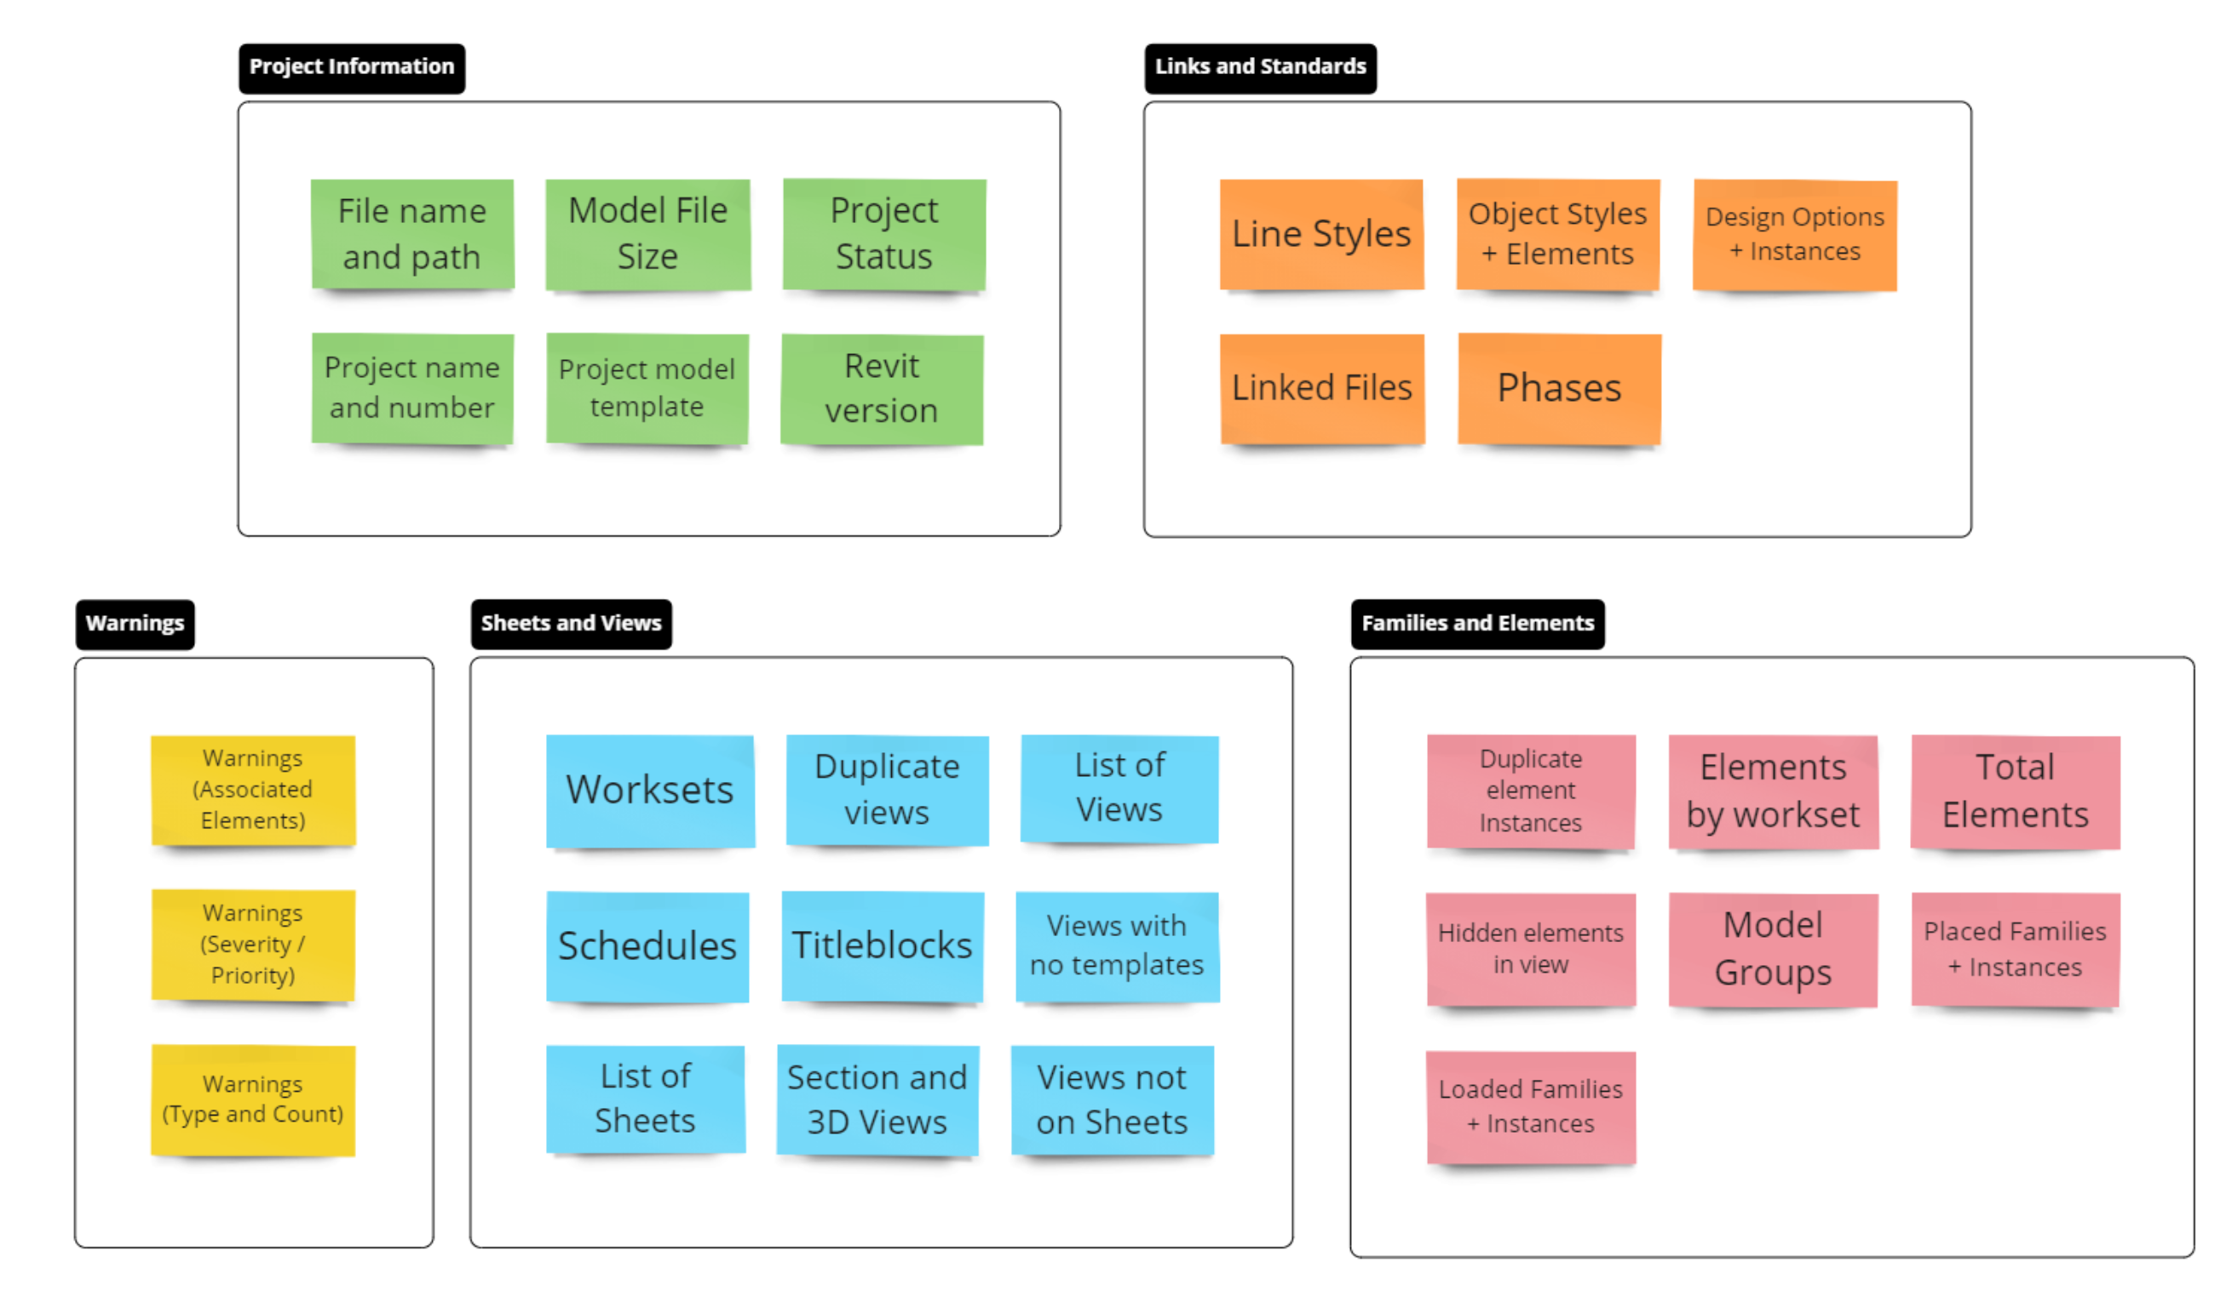
What indicators / metrics are we capturing?
NOTE:
List is NOT comprehensive
Groupings are subjective
Indicators represents primary data of interest that are actionable AND can be extracted from a Revit model. A good start for any model health report!
DIGITAL BUILT WEEK AMERICAS
Session 212
JUNE 15-17, 2023 | DALLAS, TEXAS
Notes:
Goal of the report is to provide actionable information.
Actionable means there is enough info to further investigate in model
Some indicators are company specific – e.g. nomenclature for templates, line styles, etc.
Project Info, Links, and Standards provide context: they don’t necessarily impact model health, but could help diagnose issues if performance was poor

Slide 8
0
1
2
3
4
5
Step 0:
SETUP AND DEPLOYMENT
DIGITAL BUILT WEEK AMERICAS
Session 212
JUNE 15-17, 2023 | DALLAS, TEXAS

Slide 9
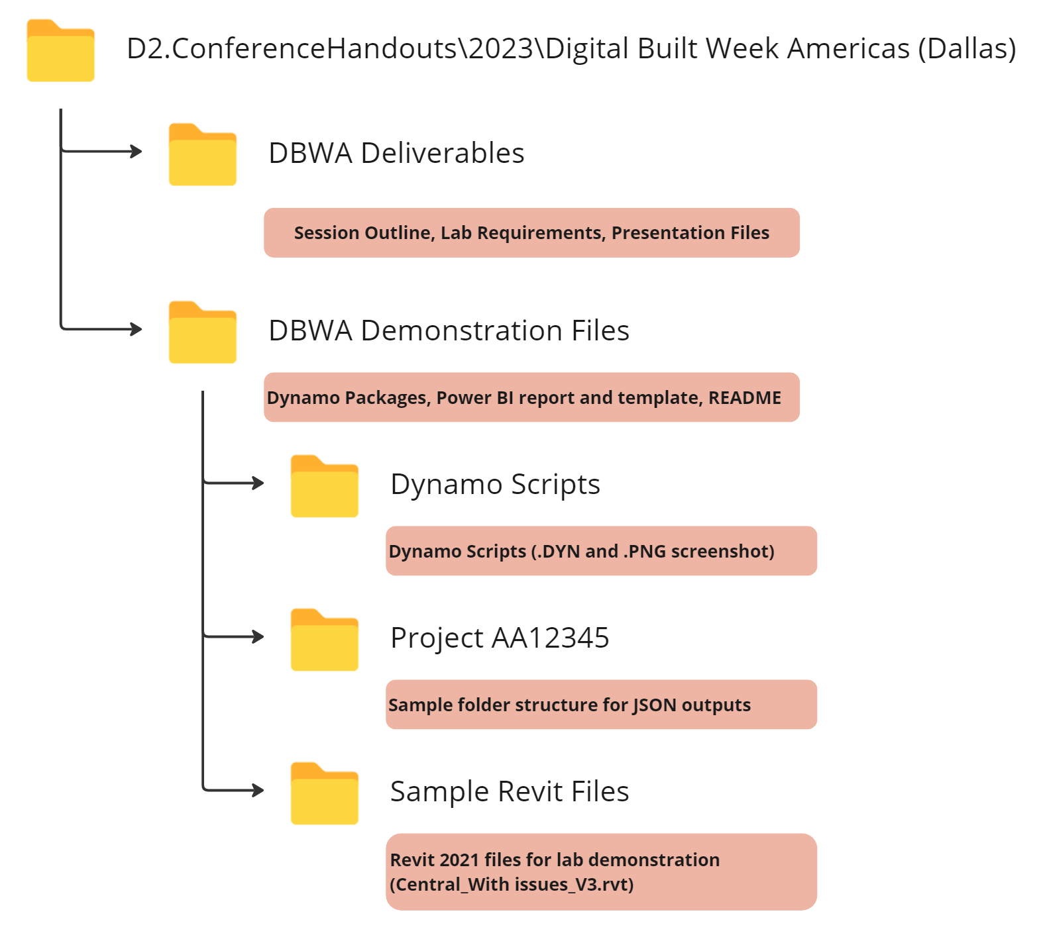
0
1
Step 0: File Deployment
2
3
Goal:
Download repo to machine
e.g. to C:\_GitHub Repos, C:\_scratch
Create Output Folder for JSON files
Option 1: Create your own
Option 2: just our sample directory
(i.e. Project AA12345)
4
5
DIGITAL BUILT WEEK AMERICAS
Session 212
JUNE 15-17, 2023 | DALLAS, TEXAS
Notes:
Aside:
Each JSON output allows you to specify a different output path.
You can modify each script so all JSON files use the same Project folder for outputs (i.e. use a single node)

Slide 10
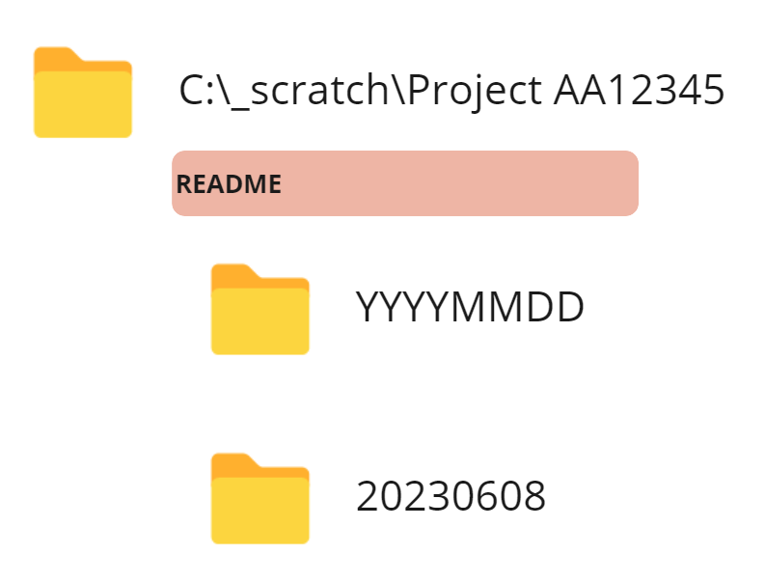
0
1
Step 0 (cont.): Example for demo
2
3
4
(1) Download Repo to: C:\_GitHub Repos
5
(2) Create JSON output folder: C:\_scratch\
(4) Empty folder for your JSON outputs; rename to today’s date
Complete set of JSON outputs
For Power BI report
(3) Copy folder to C:\_scratch
DIGITAL BUILT WEEK AMERICAS
Session 212
JUNE 15-17, 2023 | DALLAS, TEXAS
Notes:
Live Demo:
Show file structure of downloaded repo
Create scratch directory
Copy Project A12345 into folder
Update YYYYMMDD to today

Slide 11
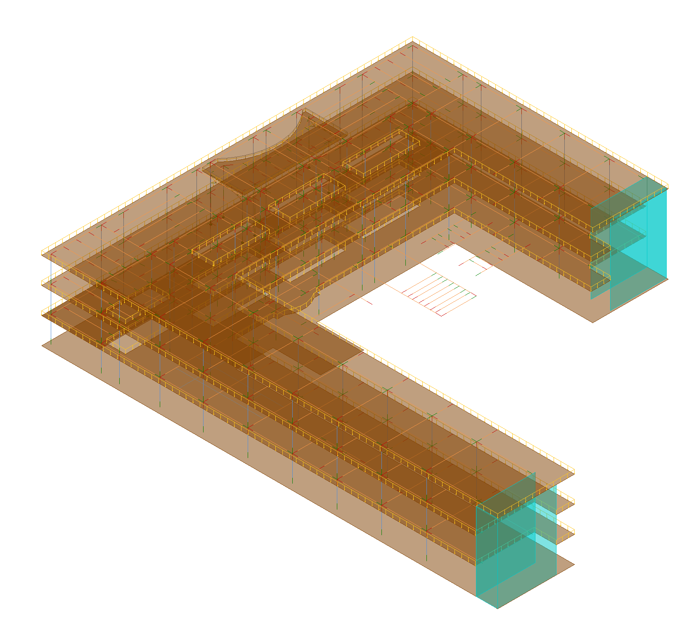
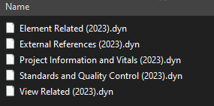
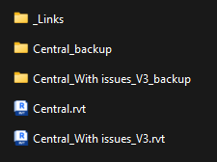
0
(messed up)
1
^
Step 0 (cont.): Use our Sample Model
2
3
Based on Revit’s advanced sample model
Errors / issues added to model to demonstrate report features
4
5
Central_With issues_V3.rvt
DIGITAL BUILT WEEK AMERICAS
Session 212
JUNE 15-17, 2023 | DALLAS, TEXAS
Notes:
Live Demo:
Show location of Dynamo Scripts and Revit Sample Files in folder
Note that errors / issues + artificial data added to Revit sample models

Slide 12
0
1
2
3
4
5
Steps 1+2:
DYNAMO SCRIPTS
DIGITAL BUILT WEEK AMERICAS
Session 212
JUNE 15-17, 2023 | DALLAS, TEXAS

Slide 13
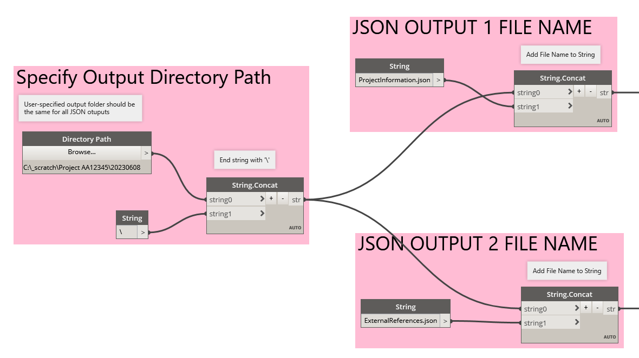
0
1
Step 1: Update Dynamo Scripts
2
3
Goal:
Each Dynamo Script exports multiple JSON files, but users need to update each w/ desired output path
First open Revit model
Open Dynamo (Manage > Dynamo)
Finally, load Dynamo script
4
5
5 Dynamo Scripts are located within Repo: …\DBWA Demonstration Files\Dynamo Scripts
For each Dynamo find pink-colored Groups, update the following nodes to your need:
Directory Path (required) – where the JSON files should go
In Step 0 of Demo, we chose this to be:
C:\scratch\AA12345\20230608
DIGITAL BUILT WEEK AMERICAS
Session 212
JUNE 15-17, 2023 | DALLAS, TEXAS
Notes:
Live Demo:
Need to ensure all outputs go to same folder, but retain individual file names
There is a special script called ‘Session 212 – Dynamo Patterns and Templates’
has alternative sets of Pink nodes that can be used in lieu
E.g. add prefix to file names

Slide 14
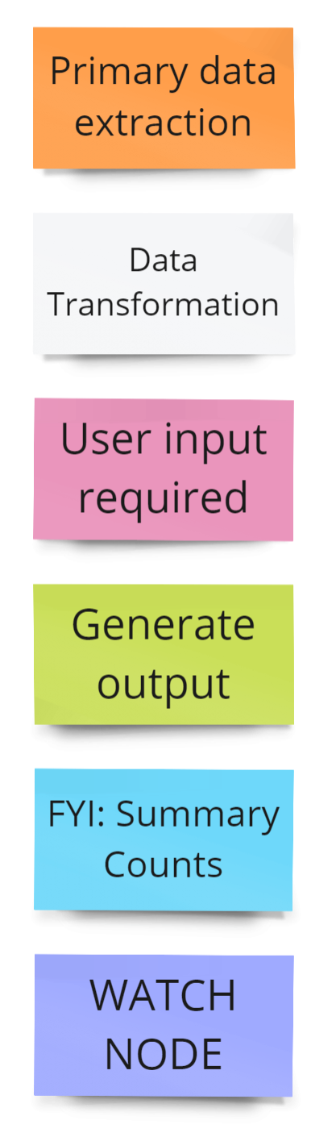
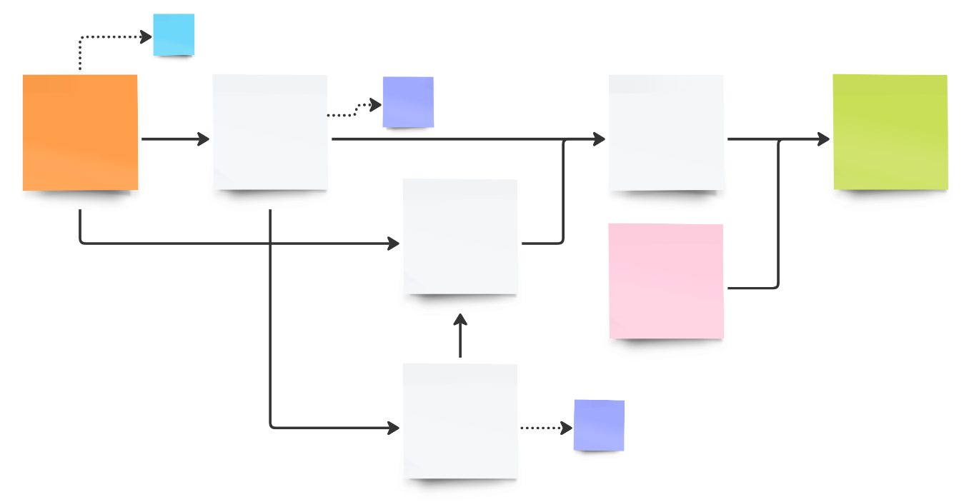
0
1
Step 1 (cont): Interpreting the Dynamo maps
2
3
Explanation
All scripts generally follow same structure
Get data -> ETL -> export as dictionary
Groups are color-coded
Lines dashed if not contributing to outputs
We will walk through one file in depth to show you primary components
Group Color | Description
Orange | Primary data extraction steps; sets scope of extracted data
Grey | Includes data transformations, e.g. filtering, sorting, reshaping,
Pink | User input is required; typically for choosing file path for output
Green | Output is created; typically a JSON output from a dictionary
Blue | Summary level counts are created (for auditing purposes only)
Purple | Indicates a watch step (for readability or auditing purposes only)
4
5
NOTE: Hi-Res Images of EACH map are located within the Dynamo Scripts folder
DIGITAL BUILT WEEK AMERICAS
Session 212
JUNE 15-17, 2023 | DALLAS, TEXAS
Notes:
* Switch to live demo after explaining group coloring
A few notes before switching to Dynamo:
More detailed explanation of steps in comments of each Dynamo map
Each Dynamo script has a PNG file located within the same folder
Use our sample JSON output files to skip running Dynamo playlist

Slide 15
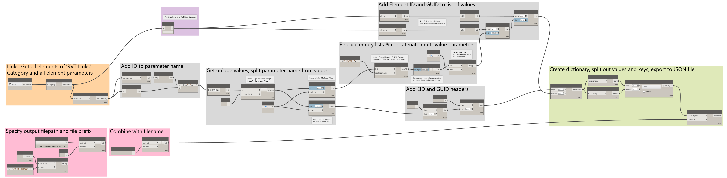
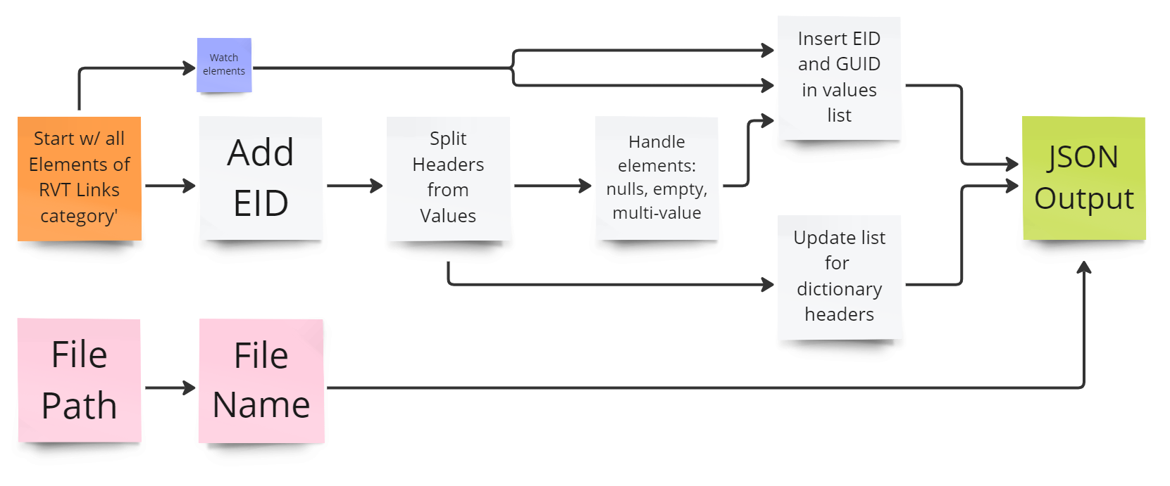
0
1
Step 1 (cont): External References (Walkthrough)
2
3
4
5
Simplified equivalent diagram based on just the groups
DIGITAL BUILT WEEK AMERICAS
Session 212
JUNE 15-17, 2023 | DALLAS, TEXAS
Notes:
Live Demo:
Navigate through External references map
Explain general structure / flow of data
Comments plastered throughout maps

Slide 16
Step 1 (cont): External References (Walkthrough)
Watch node helps developers audit elements list before transformations
Get parameter IDs and values, combine to single string for each element
Start with all elements of the ‘RVT Links’ category
Specify output folder path
Specify output JSON file name, then combine with directory to recreate full file path for data export
DIGITAL BUILT WEEK AMERICAS
Session 212
JUNE 15-17, 2023 | DALLAS, TEXAS

Slide 17
Step 1 (cont): External References (Walkthrough)
Remove empty lists and null value; concatenate parameters with multiple values into single entry. Then flatten to preserve length length and structure
Use for Dictionary Values
Add EID and GUID values to front of lists in correct sequence
Use for Dictionary Keys
Add EID and GUID headers to front of lists in correct sequence
After getting unique values, split parameter names (headers) from values
DIGITAL BUILT WEEK AMERICAS
Session 212
JUNE 15-17, 2023 | DALLAS, TEXAS

Slide 18

Step 1 (cont): External References (Walkthrough)
Move on to other Dynamo scripts…
Create dictionary using headers and values, then export to JSON file using path and name specified in Pink group nodes
Recall in Step 0, we set output folder to C:\scratch\AA12345\20230608 (or any YYYYMMDD)
DIGITAL BUILT WEEK AMERICAS
Session 212
JUNE 15-17, 2023 | DALLAS, TEXAS

Slide 19
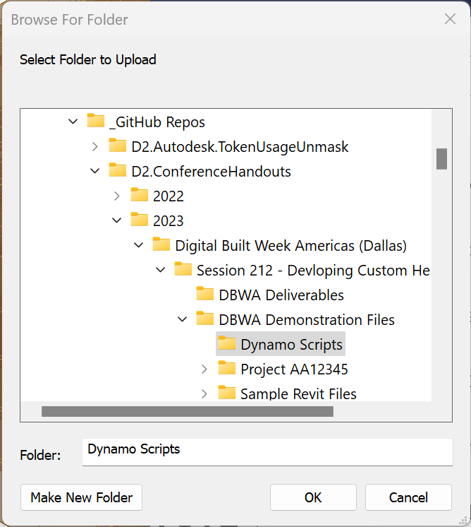
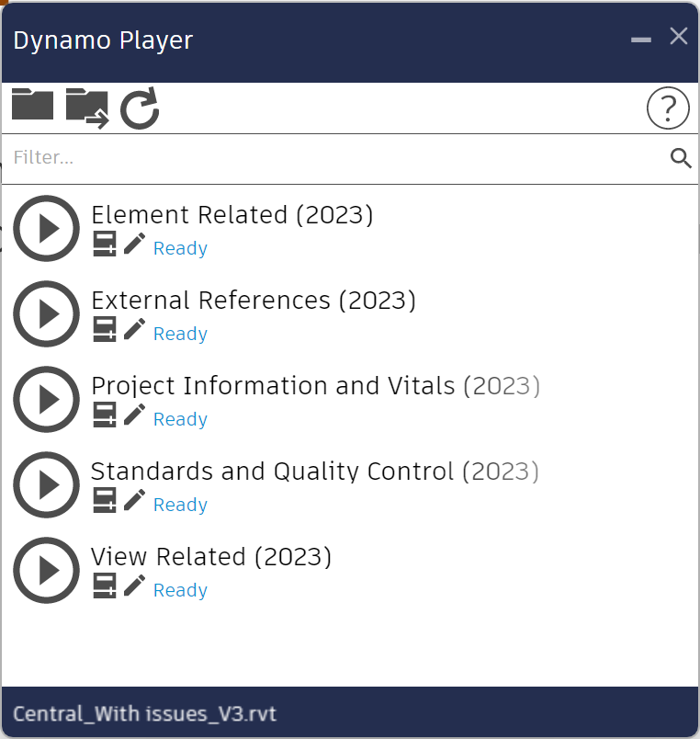
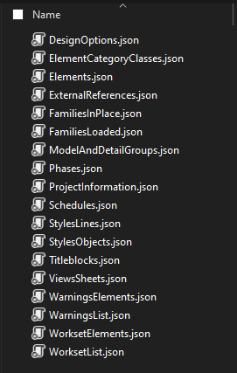
0
1
Step 2: Run All Dynamo Scripts
2
3
Goal:
Use your own model or our sample Revit 2021 model, Central_With issues_V3.rvt
After updating all scripts, run them using Dynamo Player (Manage > Dynamo Player)
4
5
C:\_scratch\Project AA12345\20230608
From Step 0: Repo in C:\_GitHub Repos
Play all scripts (Any order OK, but Elements take longest)
Check output folder for results: 18 json files
DIGITAL BUILT WEEK AMERICAS
Session 212
JUNE 15-17, 2023 | DALLAS, TEXAS
Notes:
Give brief tour of the scripts while they are running
Can use PNG images or Dynamo itself

Slide 20
0
1
Step 2: Collect JSON Outputs
2
3
Table maps relationship between Dynamo maps and JSON output files
4
5
Dynamo Map File | JSON Output
Project Information and Vitals (2023).dyn (3 outputs) | ProjectInformation.json
 | WarningsList.json
 | Warnings.json
View Related (2023).dyn (3 outputs) | Schedules.json
 | ViewsSheets.json
 | Titleblocks.json
Standards and Quality Control (2023).dyn (4 outputs) | StylesObjects.json
 | StylesLines.json
 | Phases.json
Standards and Quality Control (2023).dyn | DesignOptions.json
Dynamo Map File | JSON Output
Element Related (2023).dyn (7 outputs) | ModelAndDetailGroups.json
 | FamiliesLoaded.json
 | FamiliesInPlace.json
 | Worksets.json
 | WorksetElements.json
Element Details (2023).dyn | Elements.json
 | ElementCategoryClasses.json
External References (2023).dyn (1 output) | ExternalReferences.json
PUT ALL JSON FILES FROM THE SAME RUN IN THE SAME FOLDER!
e.g. C:\_scratch\Project AA12345\20230608
DIGITAL BUILT WEEK AMERICAS
Session 212
JUNE 15-17, 2023 | DALLAS, TEXAS

Slide 21
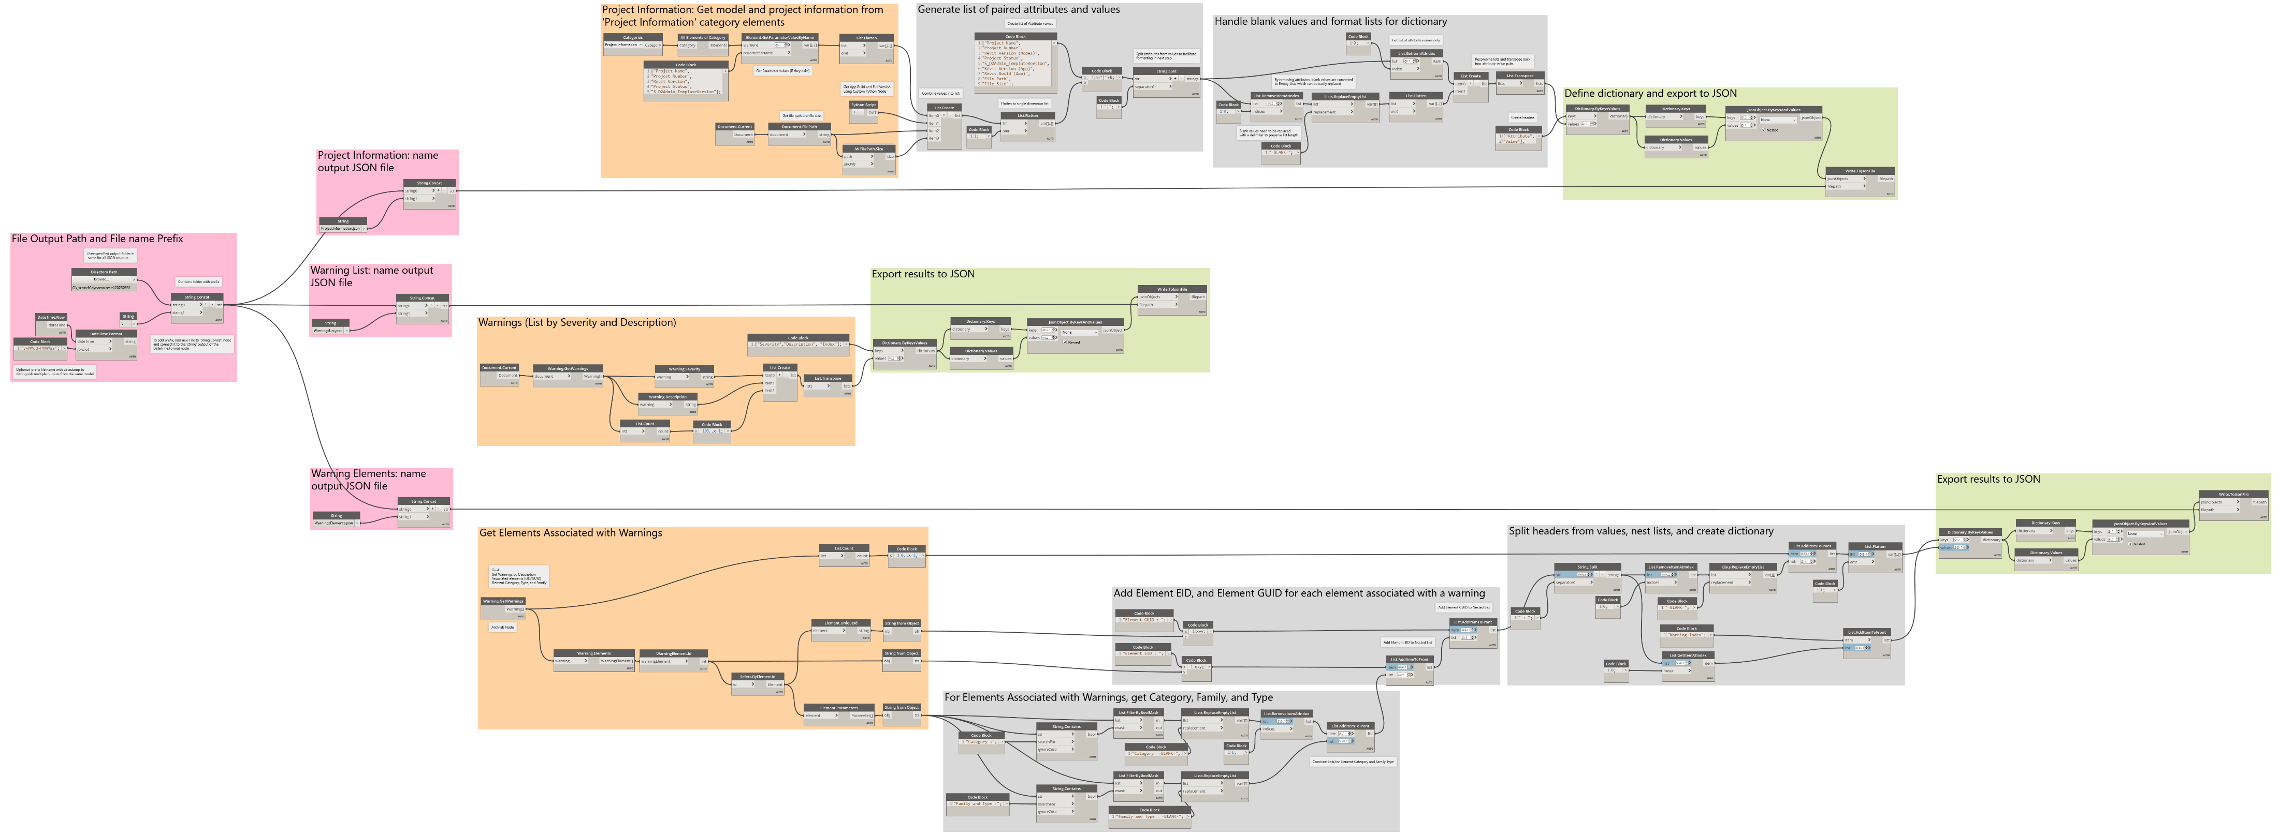
0
1
Step 2 (cont): Project Information & Vitals
2
3
JSON Outputs:
Project Information
Warnings
Warning Elements
4
5
NOTE: Hi-Res Images of EACH map are located within the Dynamo Scripts folder
NOTE: All Dynamo maps include additional comments within the map files to help inform logic
DIGITAL BUILT WEEK AMERICAS
Session 212
JUNE 15-17, 2023 | DALLAS, TEXAS

Slide 22
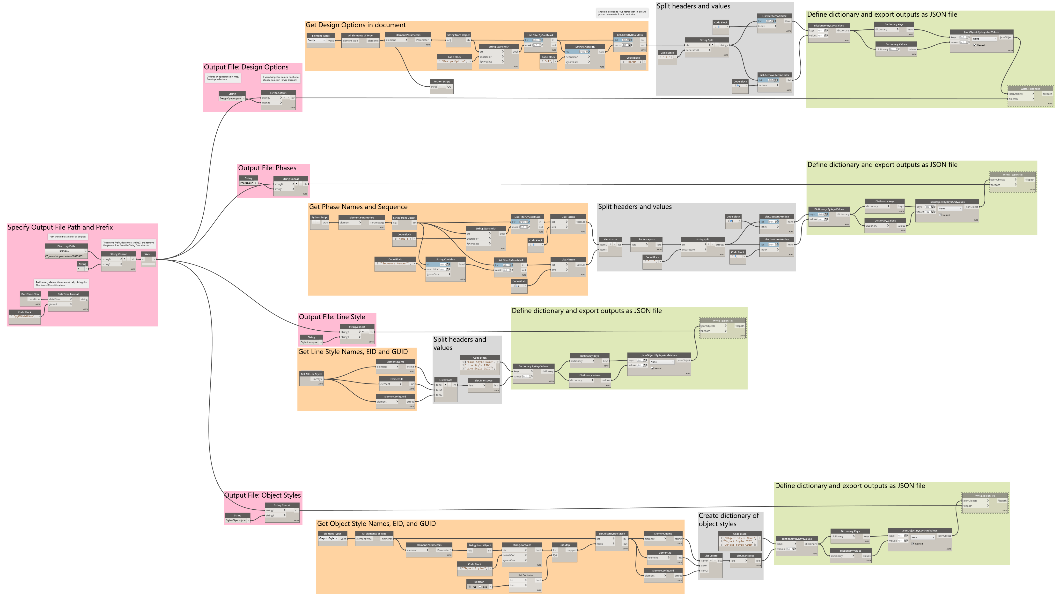
Step 2 (cont): Standards and QC
JSON Outputs:
Design Options
Phases
Line Styles
Object Styles
NOTE: Hi-Res Images of EACH map are located within the Dynamo Scripts folder
NOTE: All Dynamo maps include additional comments within the map files to help inform logic
DIGITAL BUILT WEEK AMERICAS
Session 212
JUNE 15-17, 2023 | DALLAS, TEXAS

Slide 23
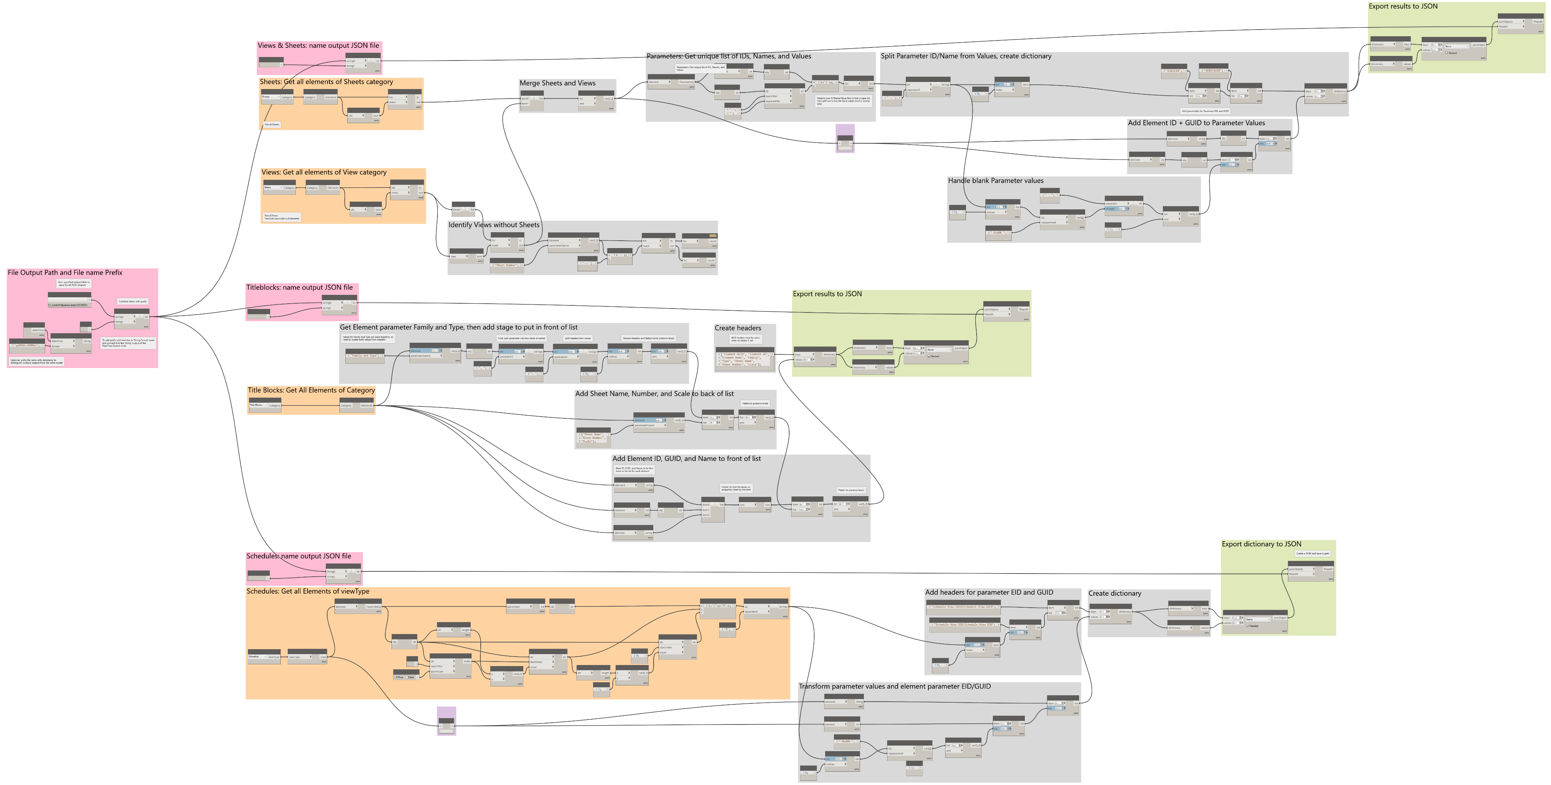
Step 2 (cont): View Related
JSON Outputs:
Views
Sheets
Titleblocks
Schedules
NOTE: Hi-Res Images of EACH map are located within the Dynamo Scripts folder
NOTE: All Dynamo maps include additional comments within the map files to help inform logic
DIGITAL BUILT WEEK AMERICAS
Session 212
JUNE 15-17, 2023 | DALLAS, TEXAS

Slide 24
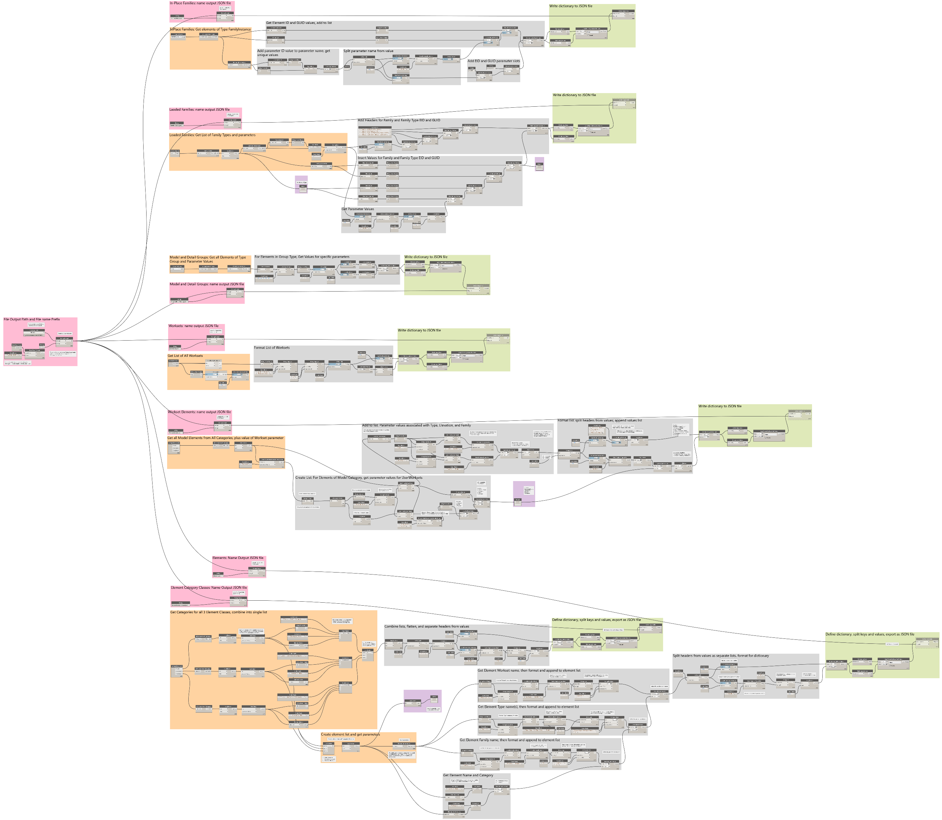
Step 2 (cont): Element Related (Part 1)
JSON Outputs:
Placed Families
Loaded Families
Model & Detail Groups
Worksets
Worksets
NOTE: Hi-Res Images of EACH map are located within the Dynamo Scripts folder
NOTE: All Dynamo maps include additional comments within the map files to help inform logic
DIGITAL BUILT WEEK AMERICAS
Session 212
JUNE 15-17, 2023 | DALLAS, TEXAS

Slide 25
0
1
Step 2 (cont): Element Related (Part 2)
2
3
JSON Outputs (cont.):
Workset Elements
Elements
Element Category Classes
4
5
NOTE: Hi-Res Images of EACH map are located within the Dynamo Scripts folder
NOTE: All Dynamo maps include additional comments within the map files to help inform logic

Slide 26
0
1
2
3
4
5
Steps 3-5:
POWER BI REPORT
DIGITAL BUILT WEEK AMERICAS
Session 212
JUNE 15-17, 2023 | DALLAS, TEXAS

Slide 27
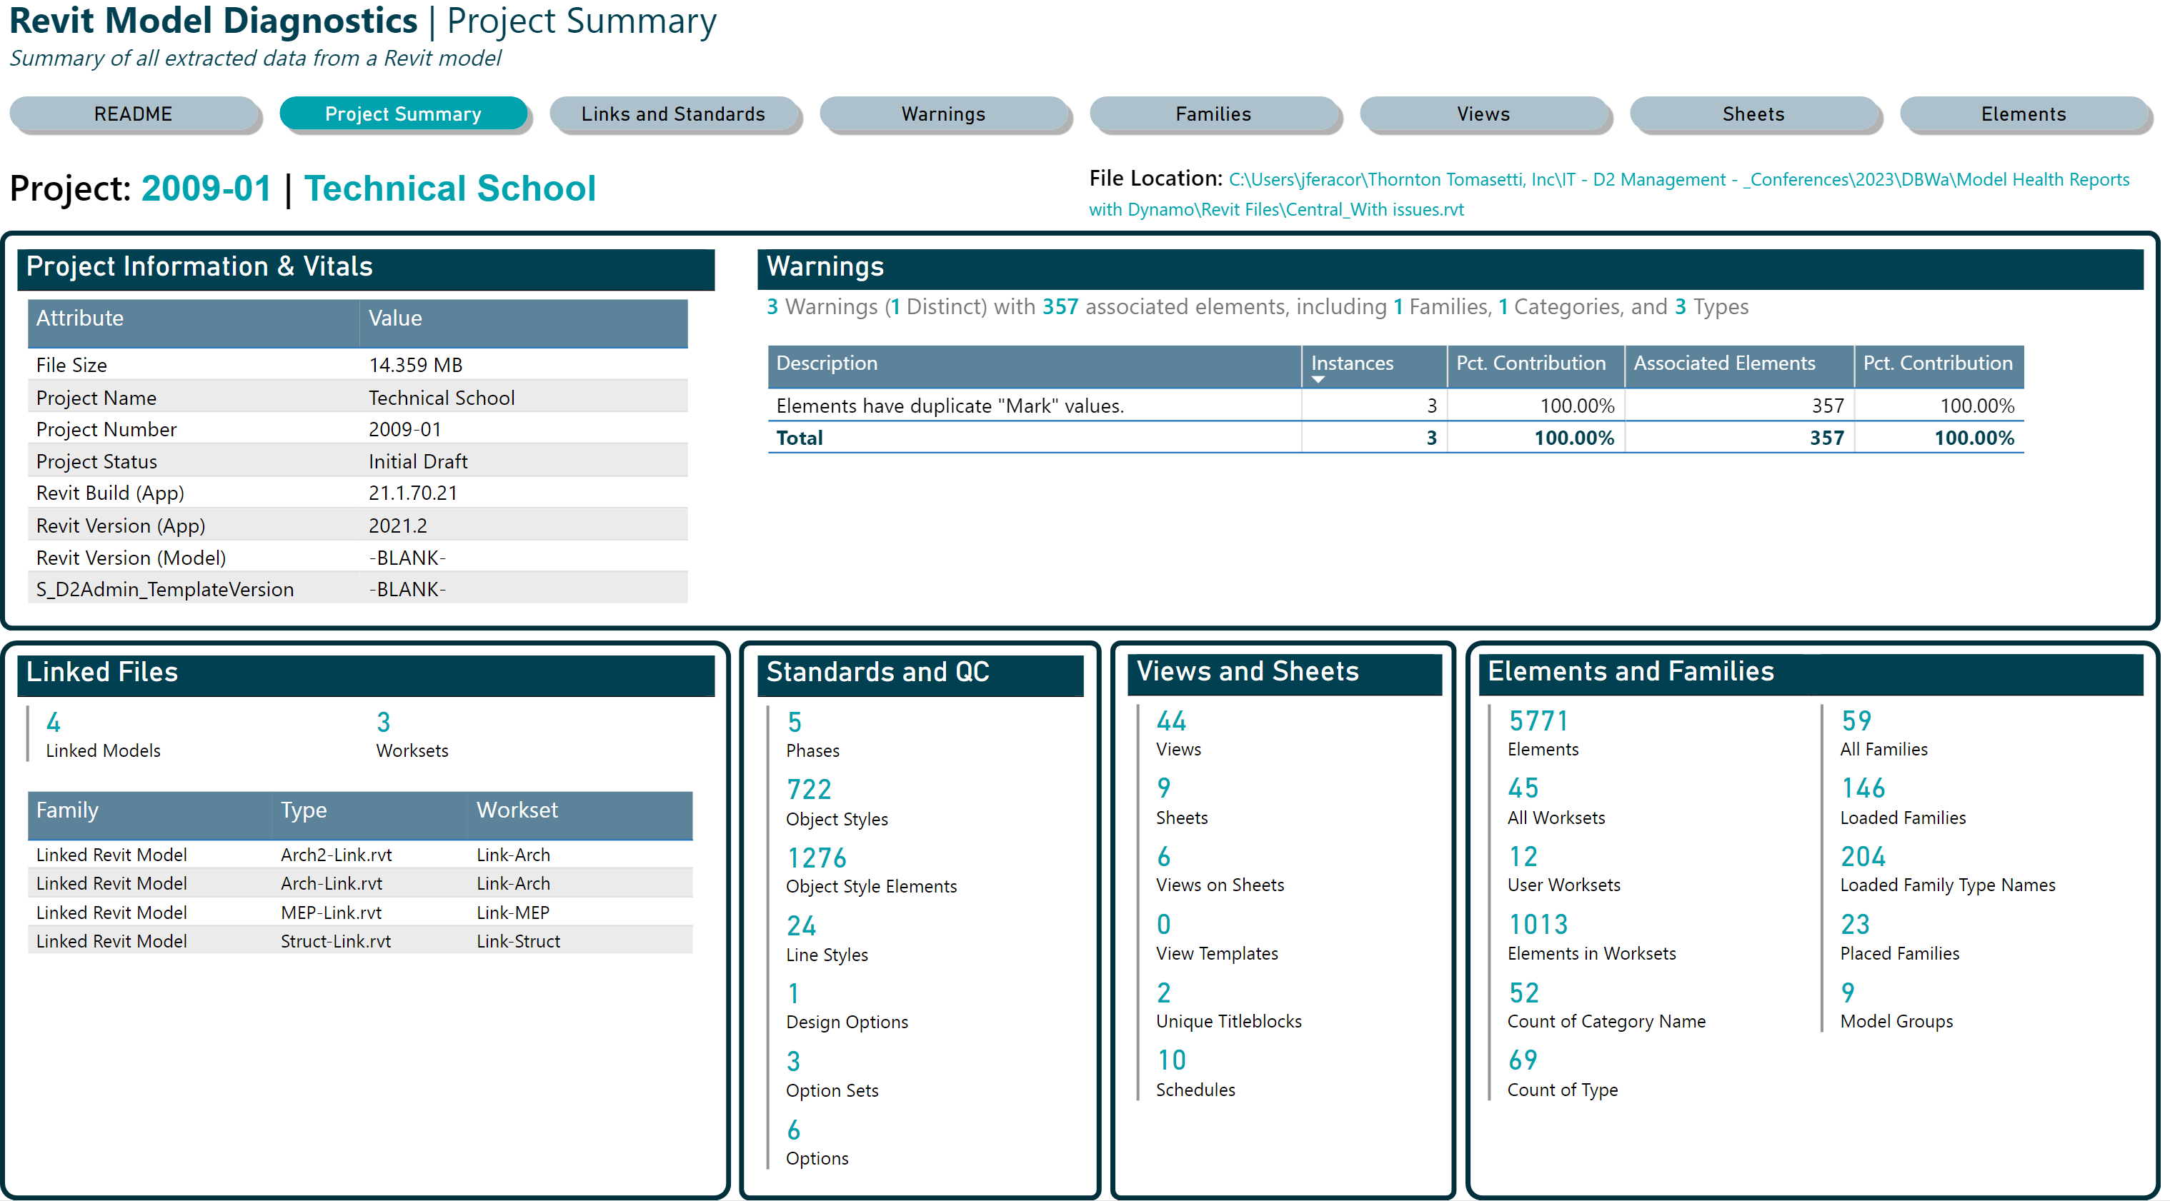
0
1
Tour of the Power BI Report…
2
3
4
5
Notes:
Live Demo:
Demonstrate the web-version of the Power BI report to show what user sees when consuming report
Can use PBI Desktop if audience more oriented to development
Visuals will load even with a free license
Link to D2’s Published Report: (only works for Digital Design staff at TT):
https://app.powerbi.com/groups/6a307633-ea0b-4c94-bc07-26973f2ad61d/reports/155ab907-7fe9-4c52-9591-92a669fb235e?ctid=0bb5c534-5234-4f04-aae4-828e00611352&pbi_source=linkShare
Some visuals won’t load without a license
Key Points
Navigation bar on the top
Some pages have detailed views
Object Styles has a special drill-through page
Some tables are related (e.g. Sheets/Views, Warnings + elements) – see Table view for details
Some tables are expandable (look for plus icons)
Generally, don’t connect tables if no need to
Any data table can be exported as data (CSV)
Can also view visuals as data tables, then export

Slide 28
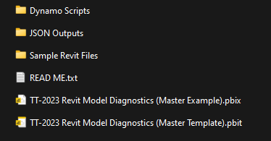
0
1
Step 3: Load Data into Power BI
2
3
Goal
Populate Power BI report with data from Dynamo (JSON files)
Two options:
Use Completed Example (PBIX file)
Data already loaded; can be further modified
Not prompted for data when opening
Use Template (PBIT file)
No data loaded
Prompt for parameter values upon opening
Will also Refresh data (i.e. Step 4 completed too)
4
Folder: …\DBWA Demonstration Files\
5
Recommendation:
Use the Completed Example to skip the Dynamo stuff and focus on modifying the report
Use the blank Template to demo the entire process
DIGITAL BUILT WEEK AMERICAS
Session 212
JUNE 15-17, 2023 | DALLAS, TEXAS
Notes:
After this slide switch to live demo

Slide 29
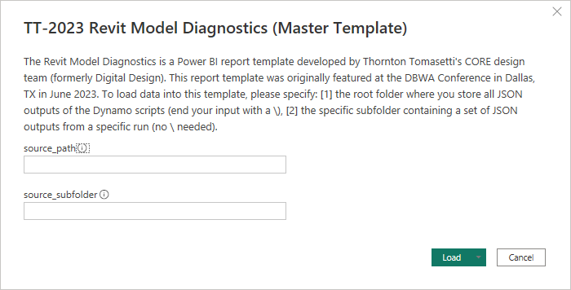
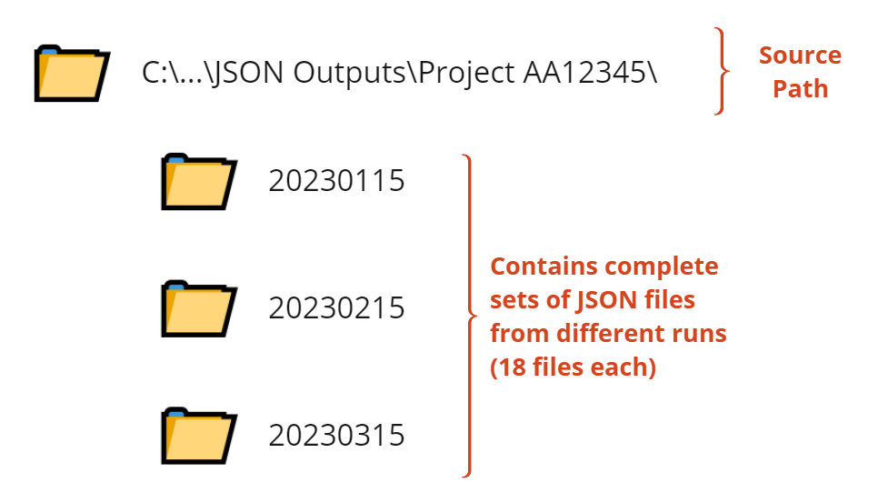
Step 3 (cont.): Load Data using Template
Goal: (When opening a blank Power BI template – PBIT file)
Template will ask user for 2 parameter values open opening:
source_path = root folder of the JSON folder
source_subfolder = subfolder containing set of JSON output files
PLEASE REMEMBER TO INCLUDE A ‘\’ AT THE END OF THE SOURCE PATH
e.g. C:\_scratch\Project AA12345\
NO ‘\’ NEEDED FOR SUBFOLDER
e.g. 20230608
When you press Load, data is also refreshed!
DIGITAL BUILT WEEK AMERICAS
Session 212
JUNE 15-17, 2023 | DALLAS, TEXAS
Notes:
Live demo:
Enter input parameters:
source_path = e.g. C:\_scratch\Project AA12345\
source_subfolder = 20230608
Be use to include a \ for the source_path, but not source_subfolder
Load data

Slide 30
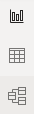
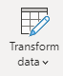
Step 3 (cont.): Power Query vs Report Editor
What the developers sees (PQ) versus what the end user sees (report editor)
Roles
Developer
End-User / Consumer
Primary Sections in Power BI
Power Query Editor
Transform and optimize the flow of data that all users will consume
Report Editor
Define the intended user experience,
customize the display of information
Intended purpose
Process data so end users don’t have to
Make reports useful and usable
Subsections
Report View
Create and format visuals
Data View
Available data as a table
Model View
Table relationships
DIGITAL BUILT WEEK AMERICAS
Session 212
JUNE 15-17, 2023 | DALLAS, TEXAS
Notes:
Live demo:
Worthwhile to clarify 2 sections in Power BI: Power Query Editor and Report Editor
PQE is primary tool for modifying individual tables
Report editor for calculations that must reference multiple tables + tailoring user experience (UI/UX)
Best practice:
Because data is loaded through PQE first, perform as much ETL as possible there
Results in better user experience because reduces amount of data consumer machine much process
Manage parameters, table names in PQE

Slide 31
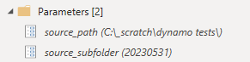
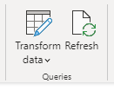
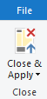
0
1
Step 4: Modify/Refresh Data in existing report
2
3
4
Goal: (When using an existing, pre-populated file – PBIX file)
In Power BI Power Query Editor, you can
update the 2 parameters in template
View and modify ETL steps from existing queries
load additional queries/tables into report
5
In Power BI Report Editor, you can
refresh changes made to data sources
refresh changes to a single table
apply changes from Power Query too
2 parameters:
source_path
source_subfolder
In the Home ribbon of the Power Query Editor, Press Close & Apply after making changes to queries
In the Home ribbon of the Power BI Report Editor, click ‘Refresh’ in the Queries section
Prefer to do additional ETL in Power Query if changes do not require data from other tables
Use DAX in Report Editor to perform additional calculations that require information spanning multiple tables
DIGITAL BUILT WEEK AMERICAS
Session 212
JUNE 15-17, 2023 | DALLAS, TEXAS
Notes:
Live demo:
Go to Power Query Editor
Show location of parameters, how to edit
Parameter allows you to update parameter once, rather than every single query
Clarify: refresh is the same in PQE and Report, but PQE is always refreshed first
You can also refresh individual tables by right clicking in Report editor

Slide 32
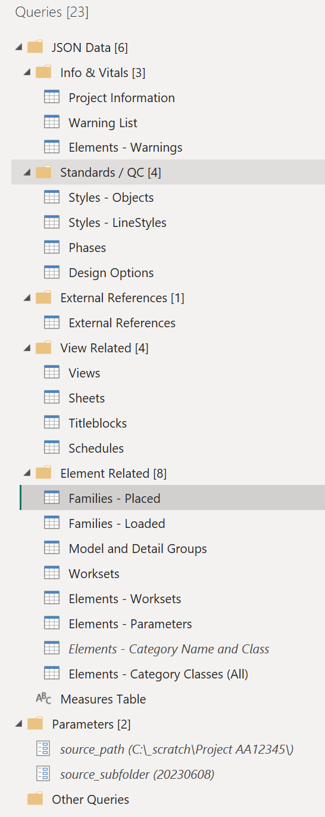
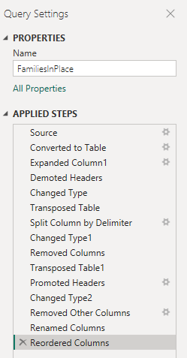
Step 4 (cont): Modify ETL in Power Query
JSON files loaded into tables(queries) in Power Query Editor of Power BI
Review or modify ETL steps by inspecting the ‘Applied Steps’ of any Table Query
Folder containing set of JSON files
Tables (Queries)
Modified copy ‘Elements – Category Classes (All)’
Disabled from Load after merging contents to Elements – Parameters
DIGITAL BUILT WEEK AMERICAS
Session 212
JUNE 15-17, 2023 | DALLAS, TEXAS
Notes:
Live demo:
ETL = extract (or export), transform, load
JSON outputs are mapped to queries in PQE
Folders are arbitrary – change as you like
Each JSON file has a corresponding query
Italicized tables are ‘disabled from load’ b/c only used in PQE (not used in report)
+2 parameters
Clicking a query will reveal list of Steps
Can also view code (aka Power M, Power Query M, M) via Advanced Editor

Slide 33
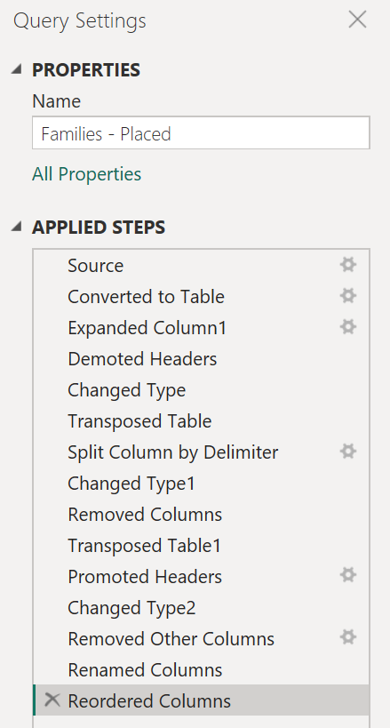
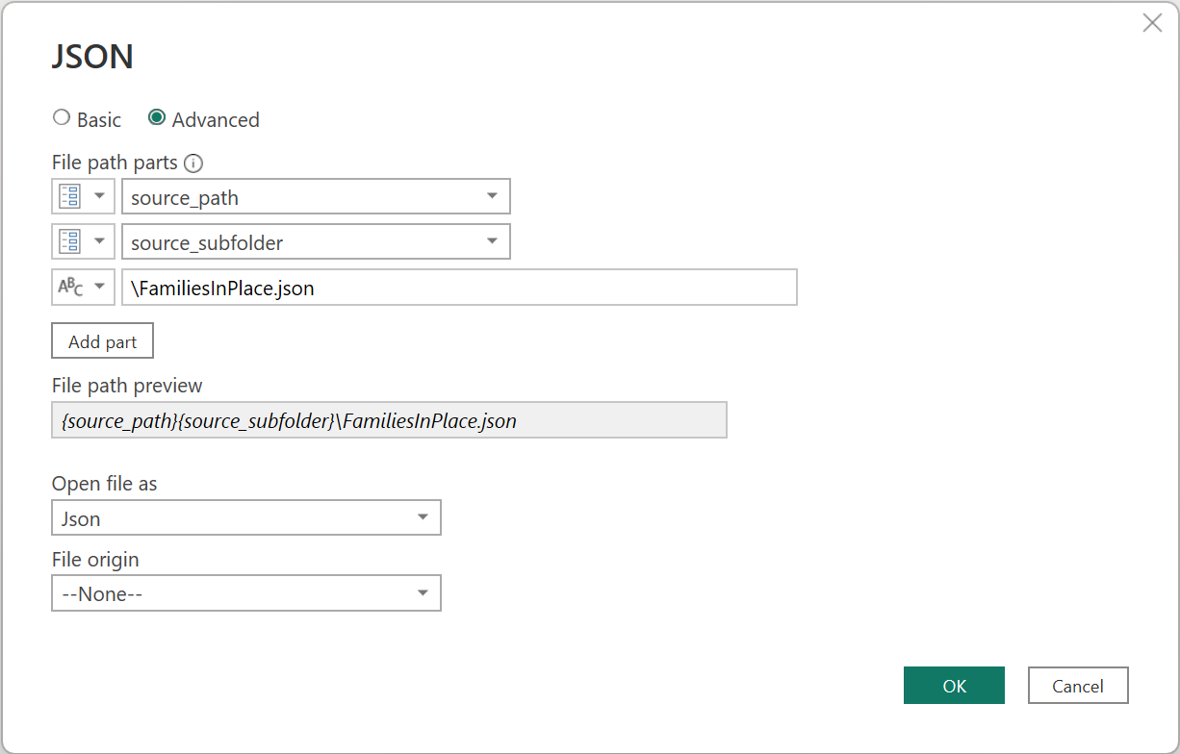
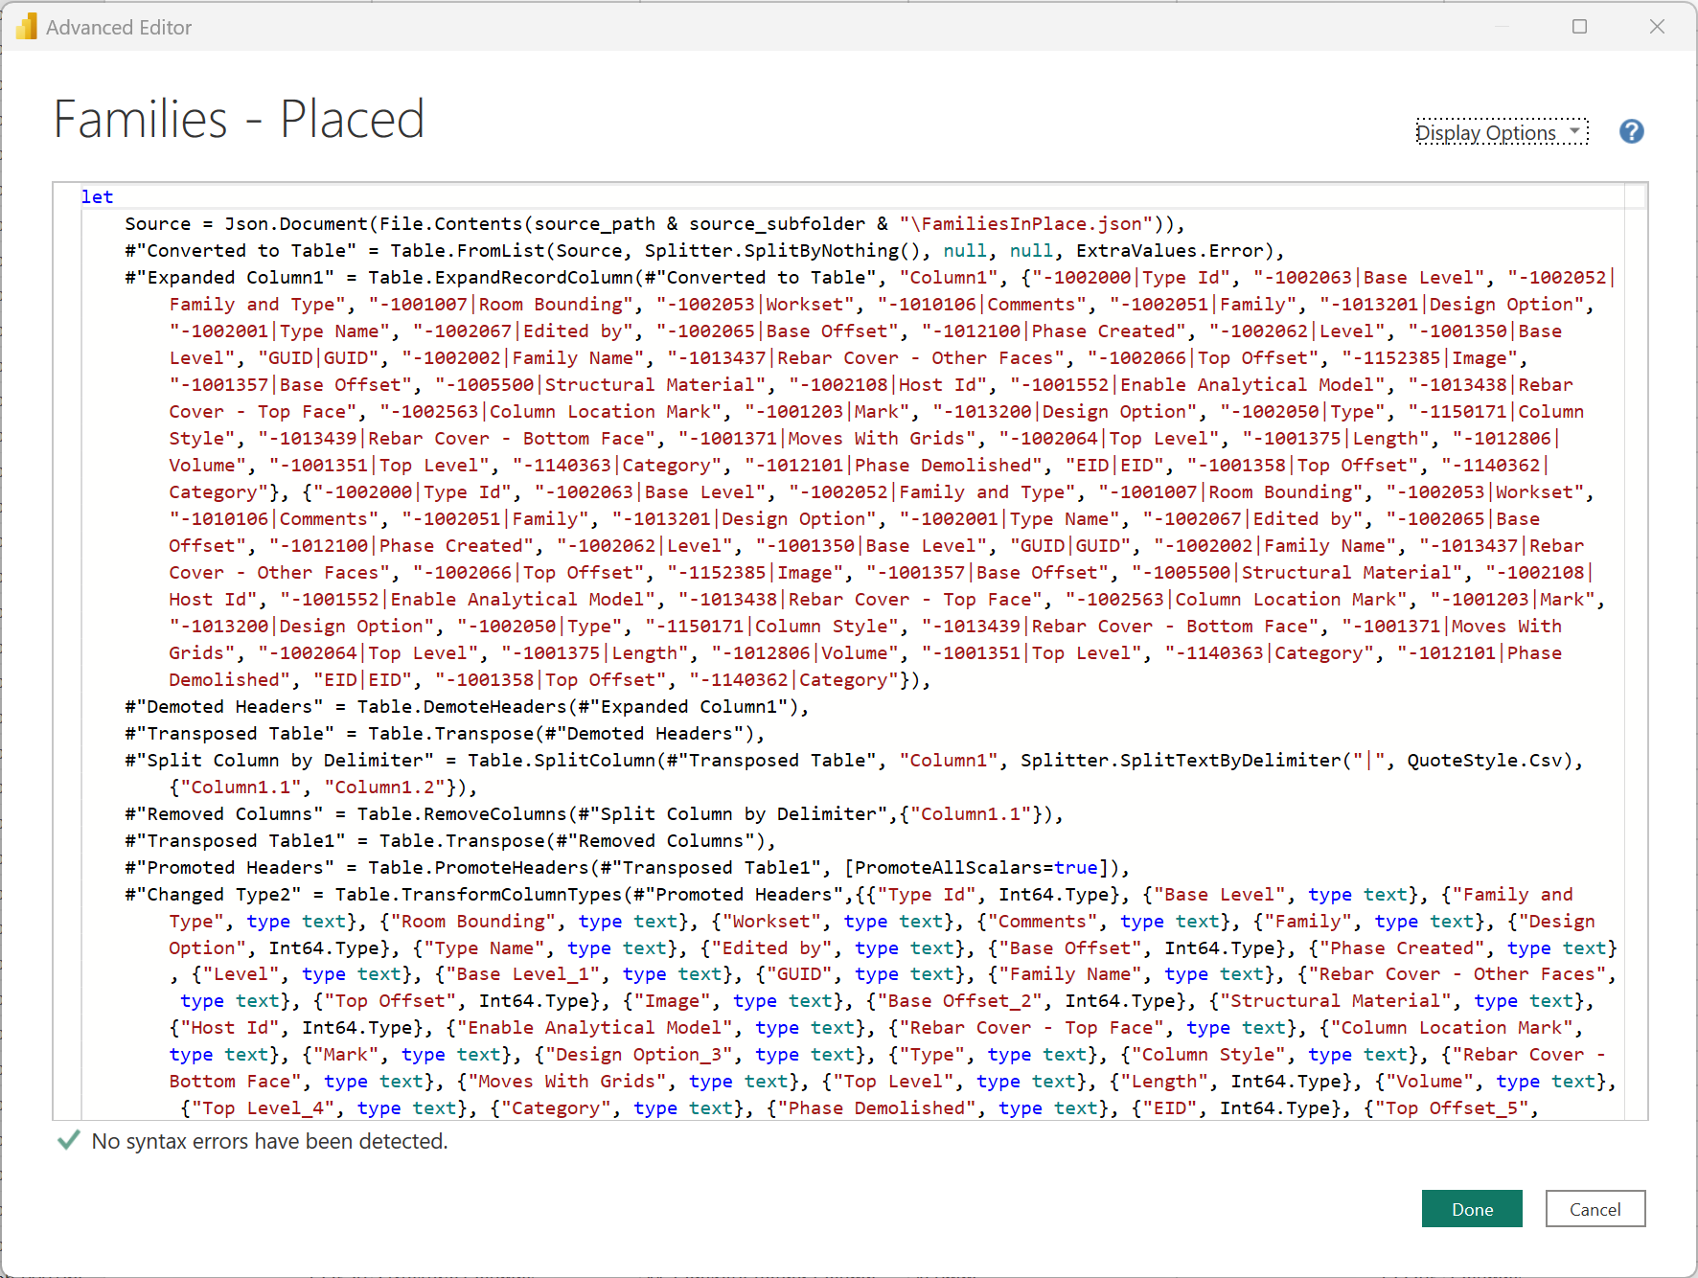
Step 4 (cont): Modify ETL steps in PQE
Modify steps with gear icons on the right
Under Home > Query > Advanced Editor
DIGITAL BUILT WEEK AMERICAS
Session 212
JUNE 15-17, 2023 | DALLAS, TEXAS
Notes:
Live demo:
Steps with Gear icons can be edited with interfaces
Otherwise, must edit step from code directly using Advanced Editor
Not covered in detail at lab, but usually will have to edit this if load fails

Slide 34
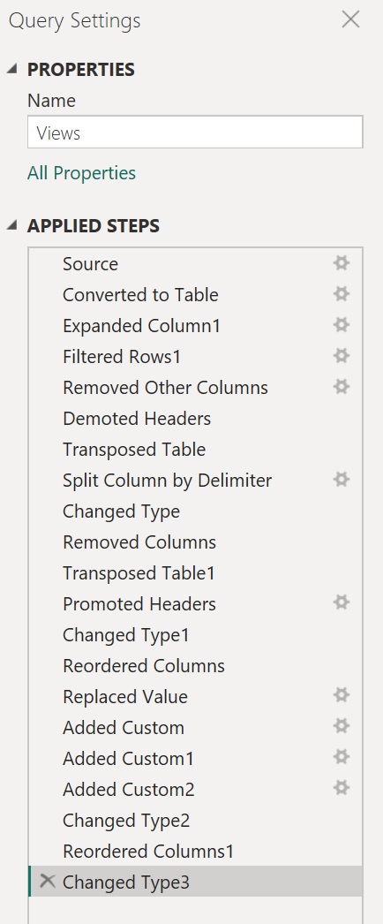
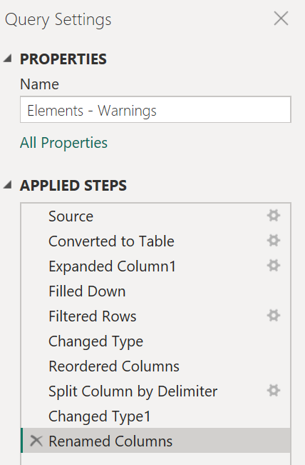
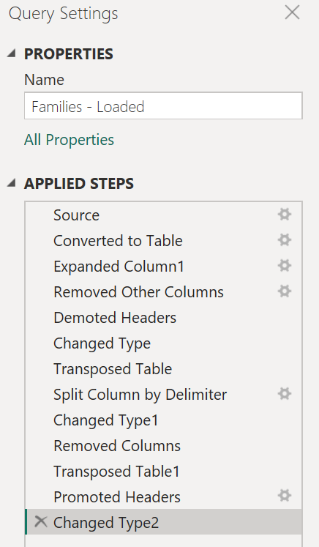
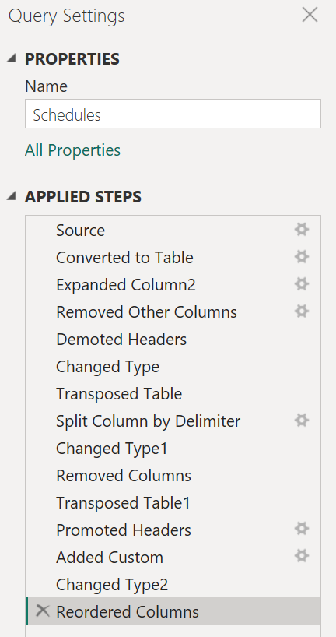
Step 4 (cont): ETL generalization
Load JSON file via Parameters
Convert to table
expand columns
Remove Unused Data (Rows or Columns)
Fix Header Names
Format column data types
Moidfy / Add Custom Columns
Rename, Reorganize, reorder
DIGITAL BUILT WEEK AMERICAS
Session 212
JUNE 15-17, 2023 | DALLAS, TEXAS
Notes:
Live demo:
Some patterns to note:
First three steps are always the same for loading JSON files
Use of Parameters in Source allow us to update all queries simultaneously
Remove unused data columns as early as possible (faster ETL)
Some tables require headers to be fixed
Demote headers, transpose table
cut off unused parts
Transpose back, promote headers
Format columns so they are the correct type in the Power BI report

Slide 35
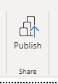
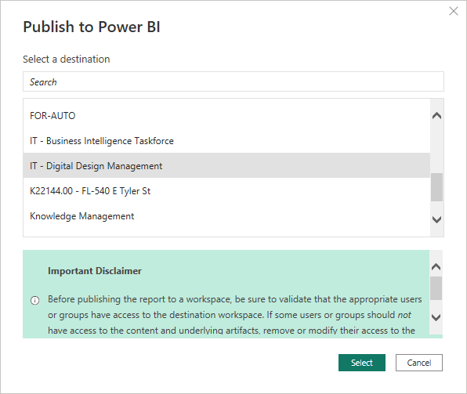
0
1
Step 5: Publish report to a Power BI workspace
2
3
Goal:
Publish the completed report to a Power BI Workspace using a Power BI Pro license
Publish using Power BI Desktop, but workspaces are only available with Power BI Pro
Go to Web Service to inspect results
Get a Share link or embed in Microsoft Teams
4
In Report Editor, go to Home ribbon, then press Publish…
5
Why do this?
Publishing and refresh automation
Smoother user experience when data is pre-loaded
Source data / report is preserved; viewers get a copy
Secure web access via persistent URL
Possible to Embed via Teams, PPT
Caveat: Premium feature of most data viz platforms
Choose a workspace, then press Select
DIGITAL BUILT WEEK AMERICAS
Session 212
JUNE 15-17, 2023 | DALLAS, TEXAS

Slide 36
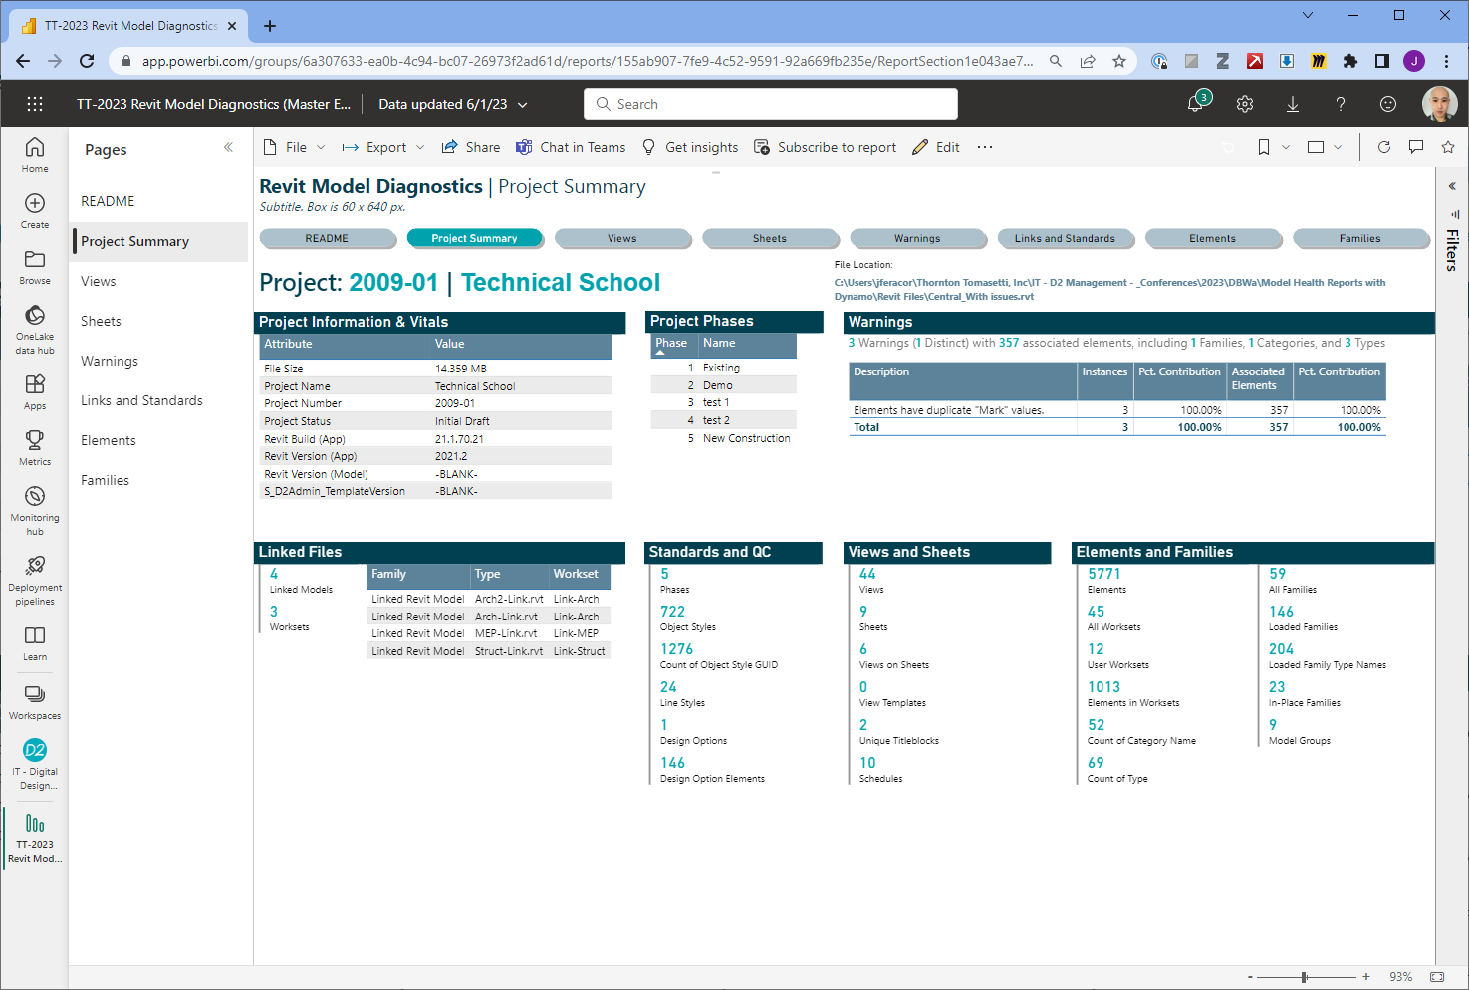
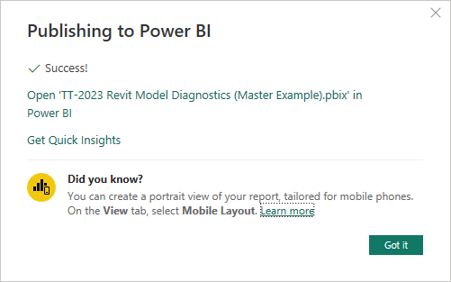
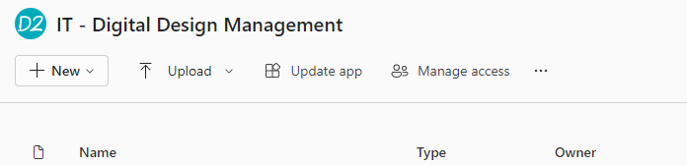
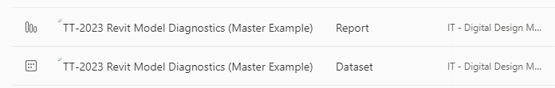
Step 5 (cont.): Inspect in Power BI Service
Goal:
After successful publish, go to app.powerbi.com
Navigate to the destination workspace
Locate board
View the Report, not the Dataset
DIGITAL BUILT WEEK AMERICAS
Session 212
JUNE 15-17, 2023 | DALLAS, TEXAS

Slide 37
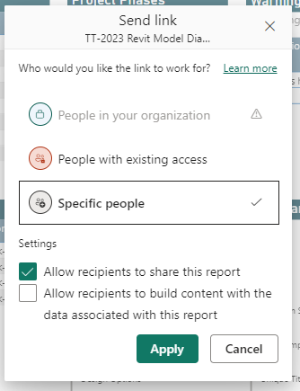
Step 5 (cont.): Get Share URL
Get Share URL by pressing ‘Share’ Button when viewing report
If Power BI workspace is associated with a channel in Microsoft Teams, members automatically gain access
To PDF, image, or PowerPoint embed
DIGITAL BUILT WEEK AMERICAS
Session 212
JUNE 15-17, 2023 | DALLAS, TEXAS

Slide 38
0
1
2
3
4
5
DISCUSSION:
SCALING CONSIDERATIONS
DIGITAL BUILT WEEK AMERICAS
Session 212
JUNE 15-17, 2023 | DALLAS, TEXAS

Slide 39
Discussion: Dynamo Pros and Cons
Discussion Point: Why Dynamo?
Pros
Its free and installed with Revit
“Easily” modifiable
Consistent, repeatable, methodical
Drawbacks
Can be slow
Must be run manually
Can be prone to issues (e.g. compatability)
Issues can be machine specific
Can’t stop a run without killing Revit
Only 1 playlist at a time
DIGITAL BUILT WEEK AMERICAS
Session 212
JUNE 15-17, 2023 | DALLAS, TEXAS

Slide 40
Discussion: Power BI Pros and Cons
Discussion Point: Why Power BI?
Pros
Scalable, including free version
Active community, growing visual marketplace
Transferrable knowledge from Excel + SQL
Integrates well with many apps
Web-based platform for casual users
Drawbacks
Premium features to improve ETL speed cost extra
Resource-intensive to set up enterprise level
Learning curve to leverage features
Can be overkill for smaller companies
DIGITAL BUILT WEEK AMERICAS
Session 212
JUNE 15-17, 2023 | DALLAS, TEXAS

Slide 41
Discussion: Workflow Scaling and Improvements
In what cases is this workflow ideal?
Depends on maturity of corporate standards
Internal weighting of metrics
What are limitations to workflow?
Data storage requirements
Volume of models vs. reporting frequency
Parallel vs. Series Processing
How can this workflow be scaled?
Proof-of-concept or consumer-ready
Needs for future customization
Scope of Work
precision: which models to scan?
reporting frequency: fast enough to be informative / reported quickly enough?
Who does the development?
In-house: Dynamo, Revit API
External: Vendors, 3rd Party Contractors
Are metrics captured by other tools?
Ownership and data centralization
Do projects require more nuanced dynamo maps beyond general diagnostics?
Data to be centrally managed? Who owns?
Who maintains library of Dynamo scripts?
What are potential feature improvements?
Multiple models
Compare iterations / Trends over time
DIGITAL BUILT WEEK AMERICAS
Session 212
JUNE 15-17, 2023 | DALLAS, TEXAS

Slide 42

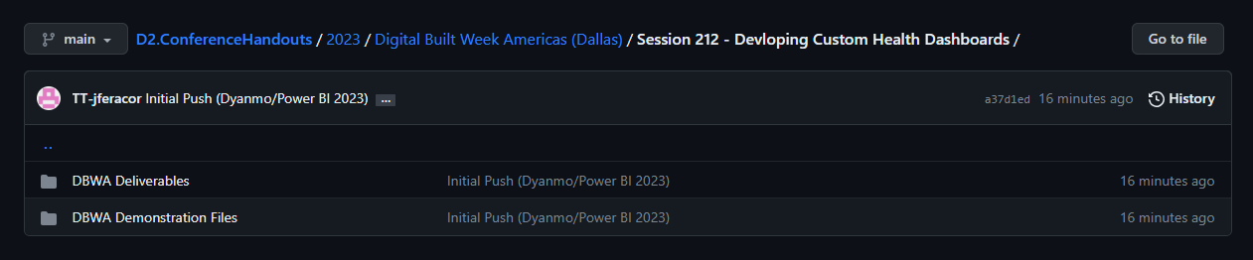
GitHub Repo
Download Session Materials from GitHub Repo
Dynamo Scripts + Images
Samples
Revit Model
JSON Output
Filled + Blank Power BI Template
Additional Resources for Devs
Deliverables for DBWA Session
Outline + Lab Requirement
Presentation
GitHub Repo
DIGITAL BUILT WEEK AMERICAS
Session 212
JUNE 15-17, 2023 | DALLAS, TEXAS

Slide 43

DIY Summary
STEP 0
Download and deploy and set up folder structure
Copy sample model
Set up manually or copy our template
0
x18
STEP 1-2
Update Dynamo Scripts, run on a model
Generate output data (JSON files)
Configure output files and manually trigger all 5 Dynamo scripts on a mode
1
2
x18
STEP 3-4:
Update Power BI Template
Read JSON files / refresh data
Modify ETL as necessary
Configure Power BI to receive data from 18 JSON file; customize report as needed
3
POWER QUERY EDITOR
+
REPORT EDITOR
4
STEP 5: (Optional for Power BI Pro users)
Publish report to a workspace
Publish a report to make report available to others via web browser
5
PUBLISH REPORT
VIA
POWER BI PRO
DIGITAL BUILT WEEK AMERICAS
Session 212
JUNE 15-17, 2023 | DALLAS, TEXAS

Slide 44

THANK YOU! QUESTIONS?
Developing Custom Health Dashboards (with Dynamo and Power BI)
DBWA2023, Session 212
Sean McDonald
smcdonald@thorntontomasetti.com
Tieyi Yu
tyu@thorntontomasetti.com
James Feracor
jferacor@thorntontomasetti.com
DIGITAL BUILT WEEK AMERICAS
Session 212
JUNE 15-17, 2023 | DALLAS, TEXAS

Slide 45
0
1
2
3
4
5
APPENDIX:
DYNAMO NOTES
DIGITAL BUILT WEEK AMERICAS
Session 212
JUNE 15-17, 2023 | DALLAS, TEXAS

Slide 46
Dynamo Maps and Package References
Table shows the Dynamo packages required for each map used in the lab
 | Dynamo Packages |  |  | Custom Nodes
Package Name: | archi-lab.net | JsonData | spring nodes | Python Nodes?
Package Version: | 2019.5.8 | 2.02 | 210.1.1
Dynamo Map File:
Element Related (2023).dyn | Y | Y | N | Workset Elements, Loaded Families
Project Information and Vitals (2023).dyn | N | Y | Y | Project Information
View Related (2023).dyn | Y | Y | N
External References (2023).dyn | Y | Y | N
Standards and Quality Control (2023).dyn | Y | Y | N | Phases
DIGITAL BUILT WEEK AMERICAS
Session 212
JUNE 15-17, 2023 | DALLAS, TEXAS

Slide 47
Dynamo Maps and JSON files
Table maps relationship between Dynamo maps and JSON output files
Dynamo Map File | JSON Output | Goal
View Related (2023).dyn | Schedules.json | Get list of schedules and parameter values for each
 | ViewsSheets.json | Get list of views and sheets, including parameters
 | Titleblocks.json | Get titleblocks and subset of key parameters
External References (2023).dyn | ExternalReferences.json | Get list of linked files and their parameters
Standards and Quality Control (2023).dyn | StylesObjects.json | Elements of Type GraphicsStyle where Parameter for 'Object Style' exists (Name, EID, GUID only)
 | StylesLines.json | List of all available line styles (Name, EID, GUID only)
 | Phases.json | List of all Documents Phases, including Parameter values for Name and Sequence Number
Standards and Quality Control (2023).dyn | DesignOptions.json | List of elements of the type Family where Parameter value for "Design Option" exists and is set (value is not blank or -1); includes Name only
Project Information and Vitals (2023).dyn | ProjectInformation.json | Project and File Information; adds context to other metrics
 | WarningsList.json | List of Warnings, including severity, description, and Error Message; intended for aggregated counts
 | Warnings.json | List of elements associated with warnings, including associated Warning description, Element Category, Family, Type, and Element EID/GUID
Element Related (2023).dyn | ModelAndDetailGroups.json | For elements of Type 'Group', gets values for specific parameters (EID, Family, Category, Type, and Level)
 | FamiliesLoaded.json | For Loaded Elements, get Family and Type values (including EID and GUID), and all Parameters
 | FamiliesPlaced.json | Get all elements of FamilyInstance type, including EID, GUID, and all parameter values
 | Worksets.json | List of Worksets found in model, including name, EID, and GUID
 | WorksetElements.json | All Elements found in model worksets, including Name, Family, Category, Type, and Workset
Element Details (2023).dyn | AnnotationElements.json | All Annotation Elements, including EUID, GUID, Family, Category, and Type
 | AnalyticalElements.json | All Analytical Elements, including EUID, GUID, Family, Category, and Type
 | ModelElements.json | All Model Elements, including EUID, GUID, Family, Category, and Type
DIGITAL BUILT WEEK AMERICAS
Session 212
JUNE 15-17, 2023 | DALLAS, TEXAS

Slide 48
APPENDIX:
POWER BI NOTES
DIGITAL BUILT WEEK AMERICAS
Session 212
JUNE 15-17, 2023 | DALLAS, TEXAS

Slide 49
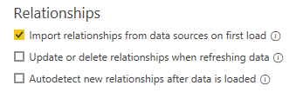
Power BI: Preparation Checklist
1. Check your version of Power BI
Template made w/ April 2023 update
Power BI not backwards compatible for this version
2. Organize JSON files into single folder
3. Turn off Auto-Detect Relationships
Power BI frequently and incorrectly tries to relate tables
Unexpected relationships can over constrain model and create refresh issues
Turn this off (if not already turned off)
File > Options and setting > Options > Current File: Data Load
UNCHECKED
DIGITAL BUILT WEEK AMERICAS
Session 212
JUNE 15-17, 2023 | DALLAS, TEXAS

Slide 50
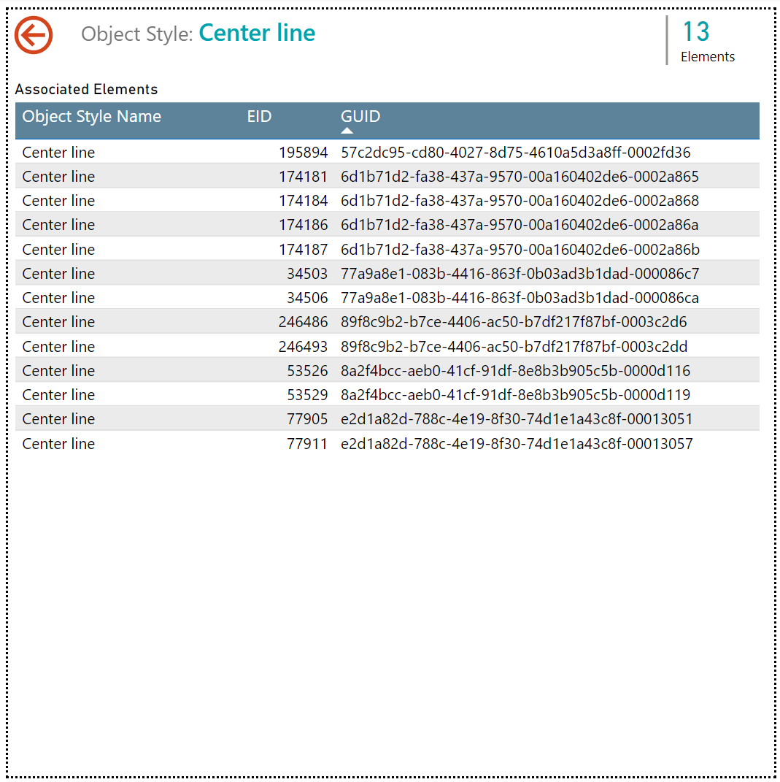
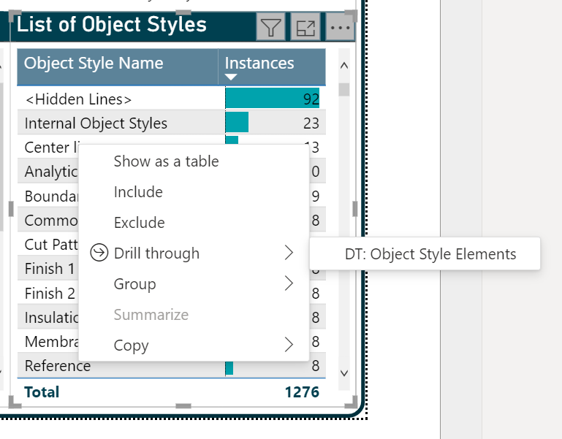
Power BI: Drill-Through Pages
Use Drill-Through (DT) Pages to hide details, but make them available on demand
DT page is based on field ‘Object Style Name’
When other visuals use this field, users can right click item and view DT page
Hidden from navigation, so user must go back to resume
Press the back button to resume
Right-click a row in ‘Object Style Name’ table
In the ‘Links and Standard’ page of the report
Click ‘Drill through’ then select any available DT pages
DT page hides a table that takes lot of space, but can be useful in this format when exported
DIGITAL BUILT WEEK AMERICAS
Session 212
JUNE 15-17, 2023 | DALLAS, TEXAS

